Slide 1
Rockbuster Stealth Data Analysis Project
Alex Lam

Slide 2
Presentation Background
Objective
Launch new online service using strategy formed from Rockbuster’s global data to compete with other streaming services
Key Questions
Which movies contributed most/least to revenue gain?
What was the average rental duration for all videos?
Which countries are Rockbuster customers based in?
Where are customers with a high lifetime values based?
Do sales figures vary between geographic regions?

Slide 3
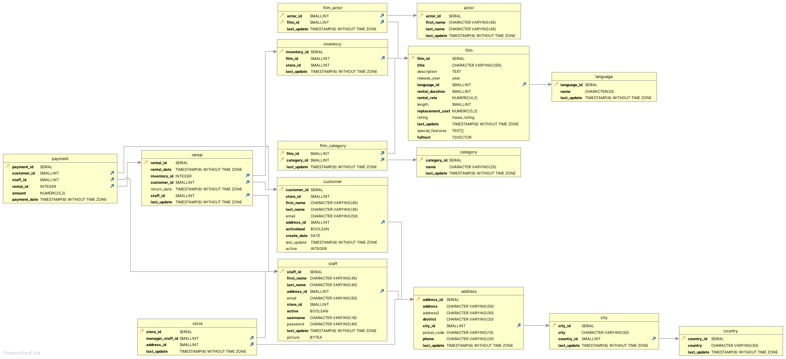
Data Tables and Their Relationships
Here is a relationship graph between all the data tables, which were provided for this analysis.
The payment, customer, and film tables were used extensively.

Slide 4
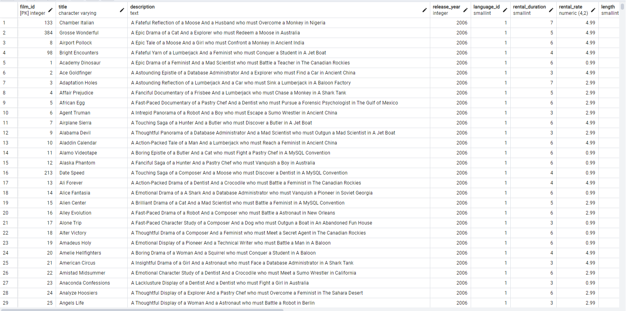
Data Screenshot: Film
To start, this slide and a few of the following will show screenshots of the raw data tables used.
This screenshot is the Film table. Variables include: film id, title, description, release year, language id, rental duration, rental rate, length, replacement cost, rating, last update, special features, and full text.
Not all variables from the tables were used as they were unnecessary for analysis, such as film id, language id, etc.

Slide 5
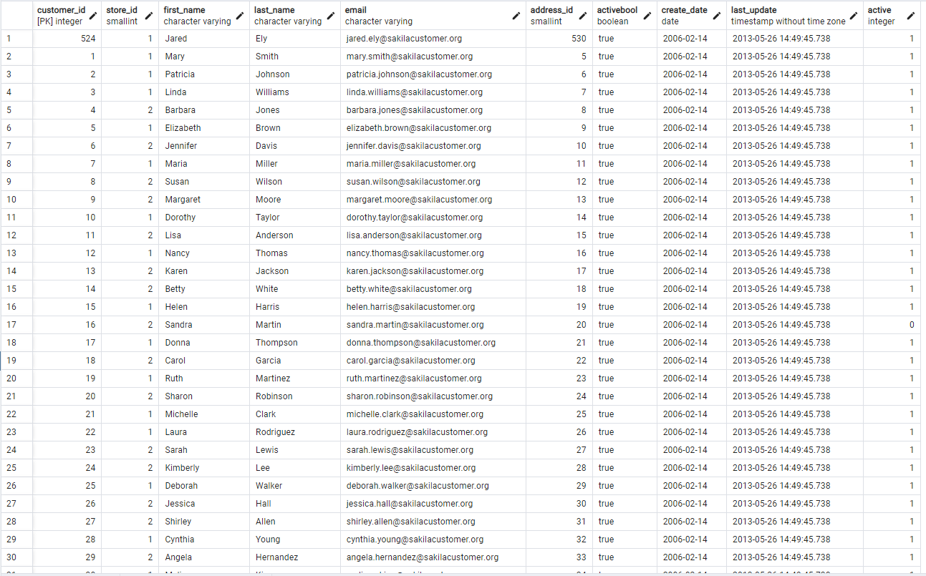
Data Screenshot: Customer
This screenshot is the customer table. Variables include: customer id, store id, first name, last name, email, address id, active bool, create date, last update, and active.

Slide 6
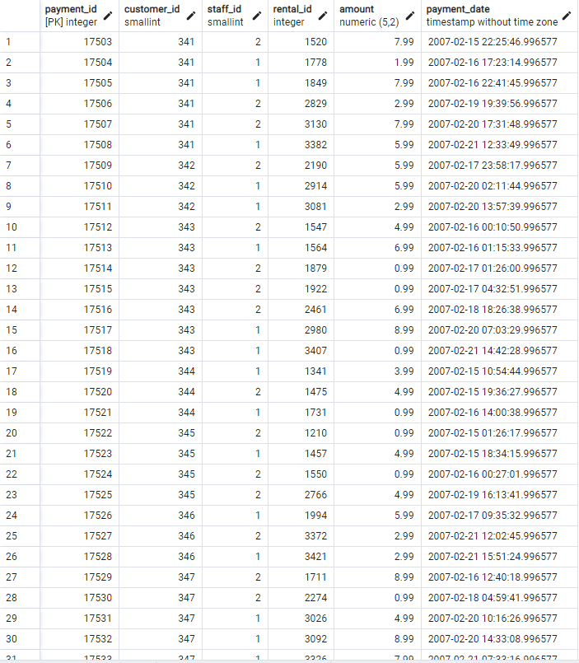
Data Screenshot: Payment
This screenshot is the payment table. Variables include: payment id, customer id, staff id, rental id, amount, and payment date.

Slide 7
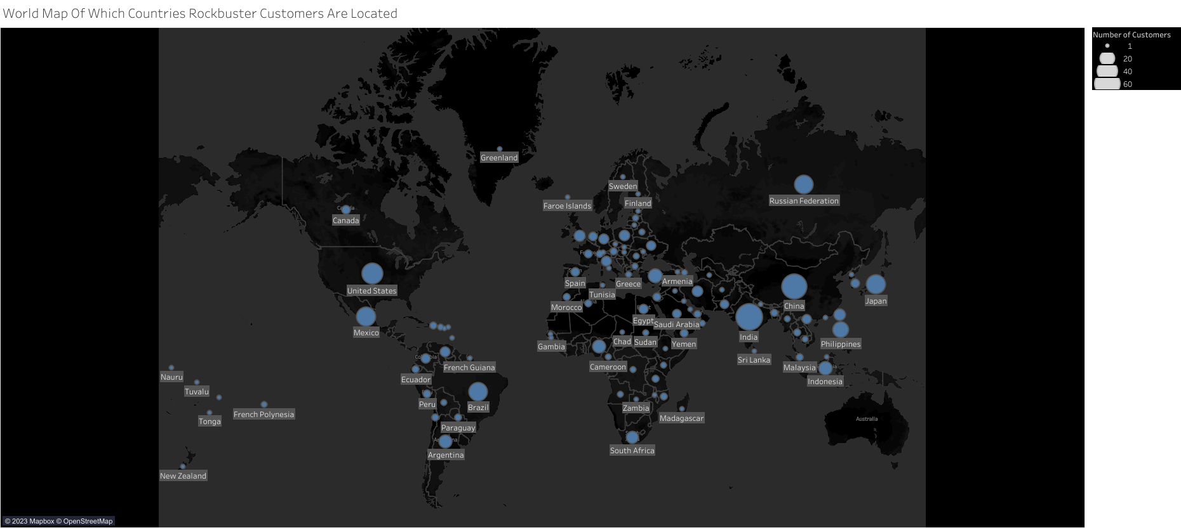
Countries and Rockbuster Customers
Rockbuster customers are located all over the world. Most continents have at least a single leading country or more in number of customers with Asia having several countries which have at least over 40 customers.
Tableau Link :
https://public.tableau.com/views/RockbusterWorldMap/WorldMap?:language=en-US&:display_count=n&:origin=viz_share_link
Tableau Link (Pages Version): This Tableau visual organizes the countries based on the exact number of customers they have.
https://public.tableau.com/views/RockbusterWorldMapPages/WorldMapPages?:language=en-US&publish=yes&:display_count=n&:origin=viz_share_link

Slide 8
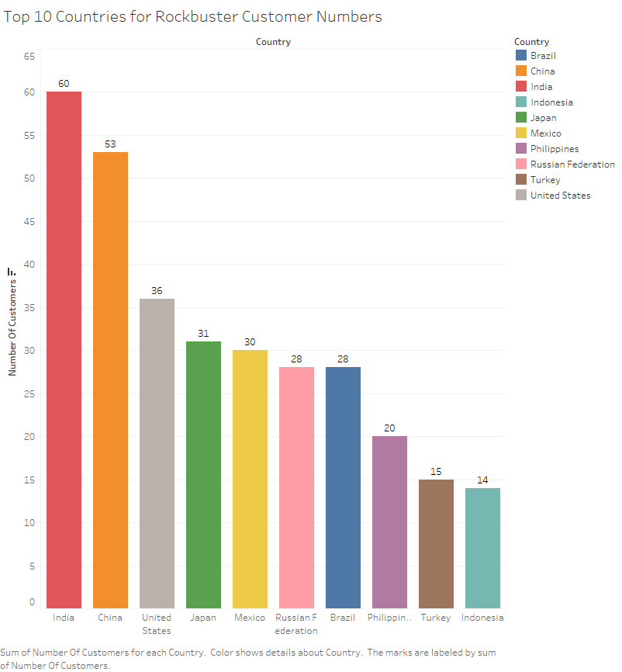
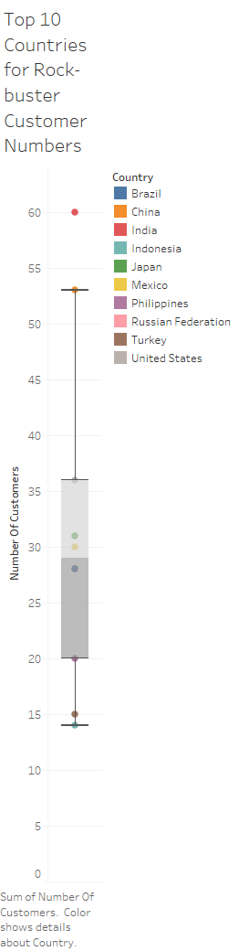
Top Countries
The top countries with Rockbuster customers are all over the world. This geographical spread further shows Rockbuster should use a different marketing strategy for all its regions.
Within the top 10 countries, only India is an outlier for its number of customers. They will need a separate marketing strategy.

Slide 9
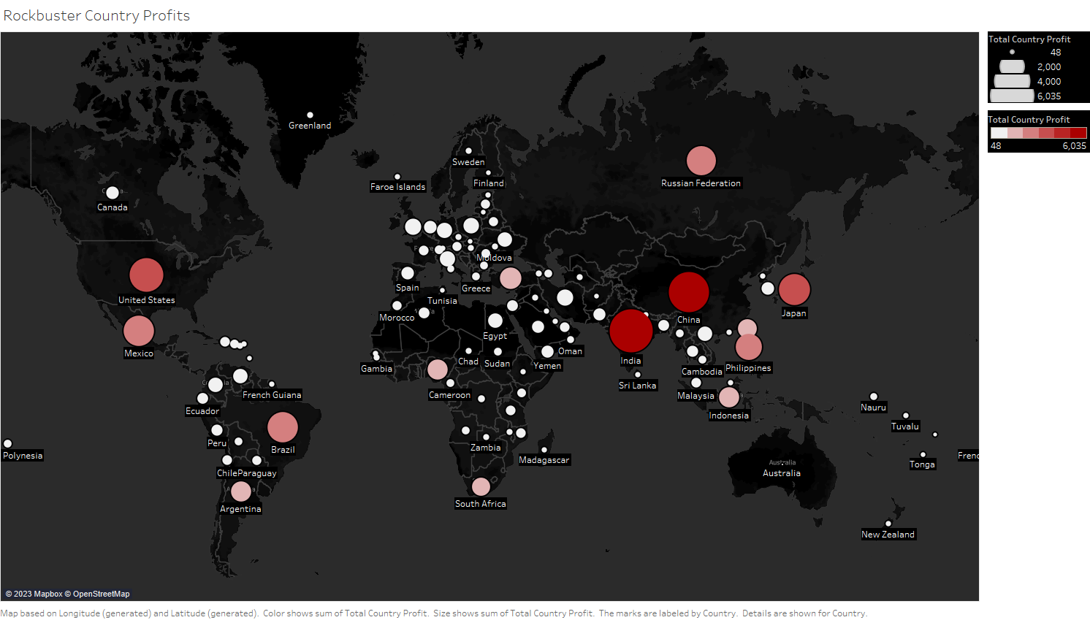
Countries and Profits
Rockbuster customers are located all over the world. Like with the number of customers, each region has at least a single leading country or more.
Tableau Link :
https://public.tableau.com/views/RockbusterCountryProfits/Sheet1?:language=en-US&publish=yes&:display_count=n&:origin=viz_share_link

Slide 10
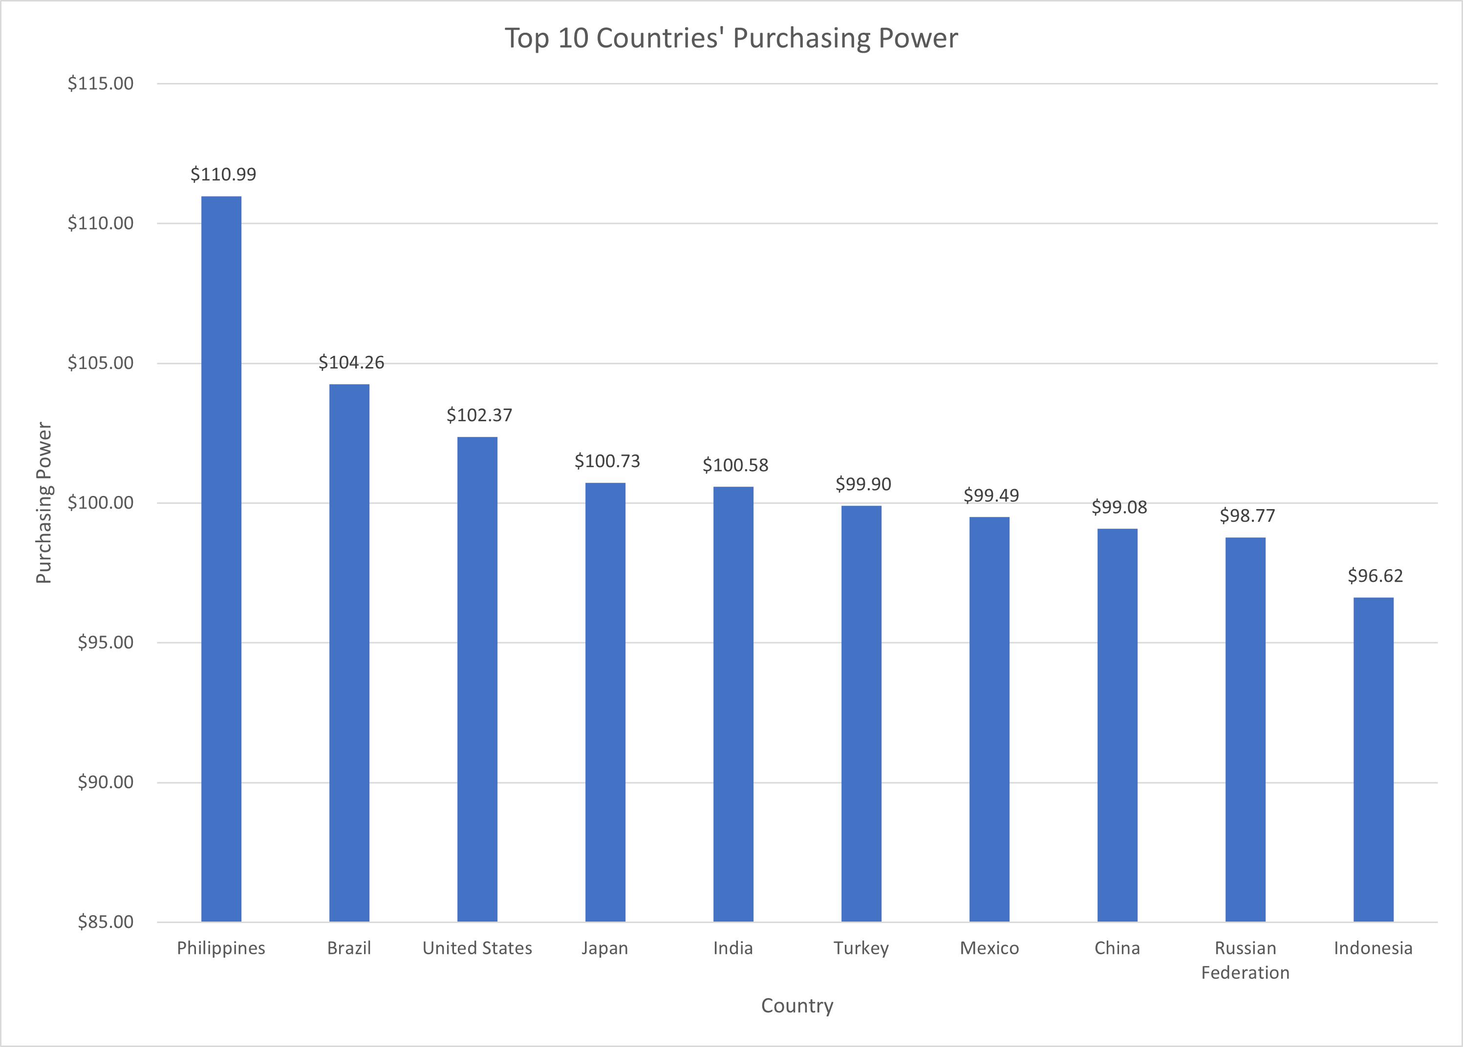
Top Countries and Their Purchasing Power
Purchasing power is determined by this formula: Country Profit / Number of Customers. This formula determines an average on how much each customer spends on rentals.
Insights: India, despite having the most customers by far, does not have the highest purchasing power. The Philippines have the highest purchasing power, but is on the lower hinge of the number of customers box and whisker graph.

Slide 11
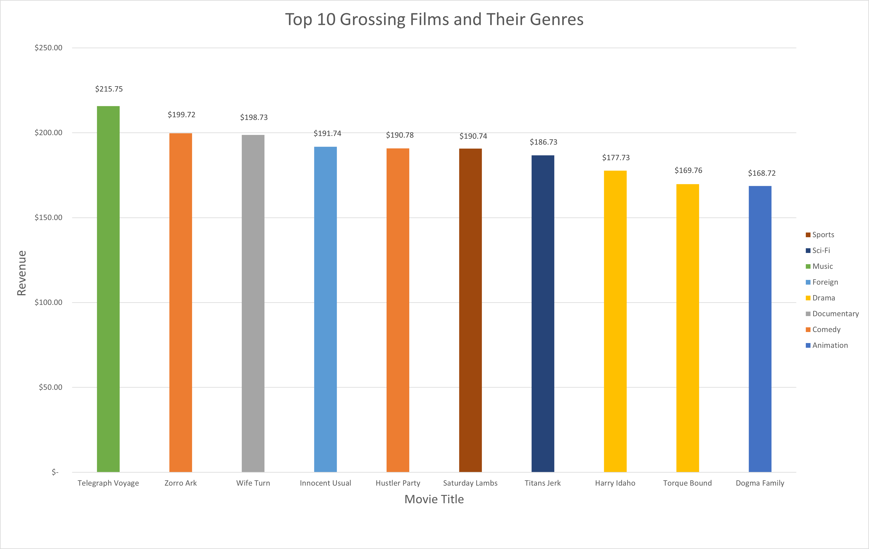
Movie Profits and Genre: Top 10 Most Profitable
These movies are the top ten most profitable movies for Rockbuster. There is no outlier movie and these films have earned similar revenue for Rockbuster. These films need to on the new streaming service.

Slide 12
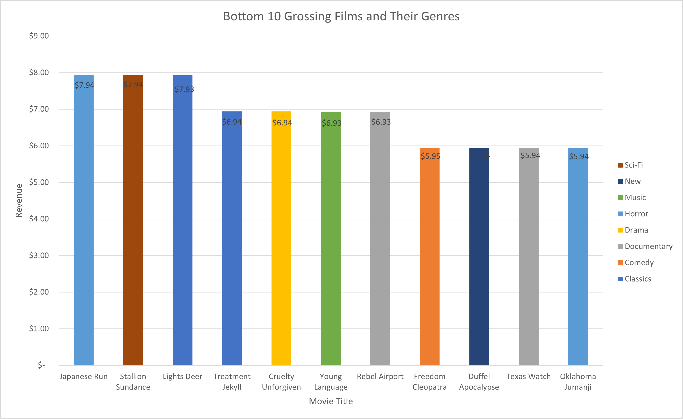
Movie Profits and Genre: Bottom 10 Least Profitable
These movies are the bottom ten most least movies for Rockbuster. Similar to the top ten profitable movies, there is no outlier movie and these films have earned similar revenue for Rockbuster. There is overlap with the most profitable movies and their genres, but horror and new genres only appear here.

Slide 13
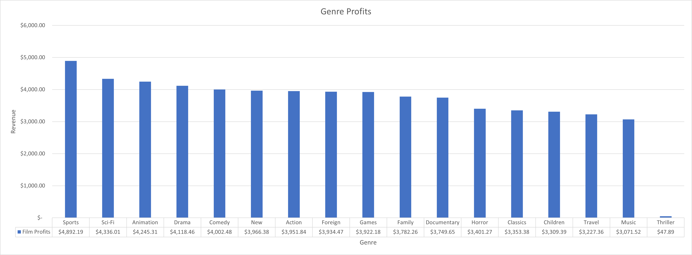

Popular Genres
These genres have made the most profit: Sports, Sci-Fi, Animation, Drama, and Comedy. These top genres are higher than the upper hinge. The top genres should be promoted either through marketing or rental deals.
Least profitable genres under the lower hinge are Classics, Children, Travel, Music, and Thriller. The horror genre is in the latter half of grossing profits and has one of its films in the bottom 10 profitable films. Horror along with the other aforementioned least profitable genres should not be prioritized in marketing.
Box and Whisker Tableau Link:
https://public.tableau.com/views/BoxandWhiskerGenreProfits/Sheet1?:language=en-US&publish=yes&:display_count=n&:origin=viz_share_link

Slide 14
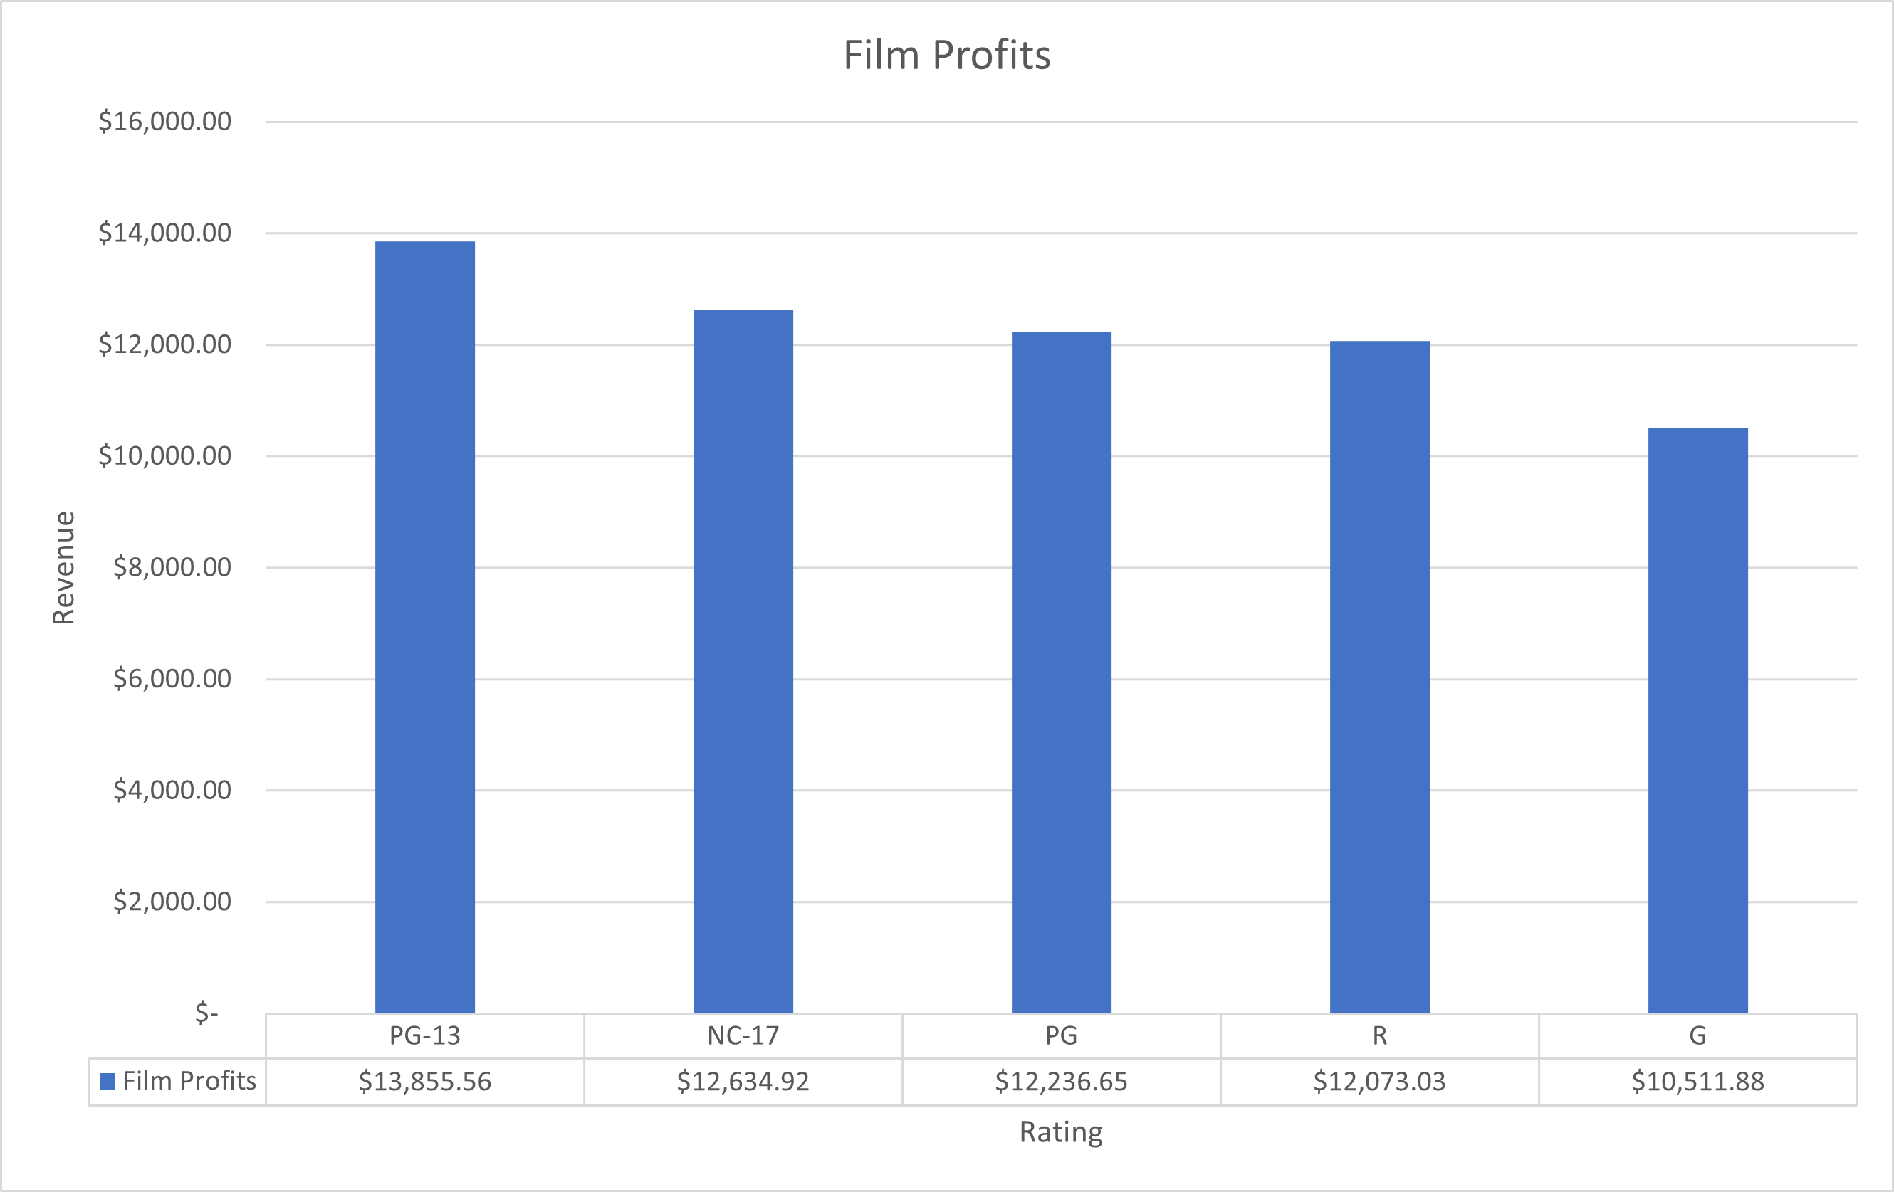
Popular Ratings
Ratings are generally not given promotion deals, but Rockbuster can still use the popularity data. The marketing team has to promote PG-13 films more often as customers are most likely to rent those films. If the proper and popular product is advertised to customers, they are more likely to rent the movies.
The G rating and Children movies do not turn a large profit, as shown with this graph and the previous genre graft.
Rockbuster is primarily geared towards adult audiences and marketing should reflect the target customers.

Slide 15
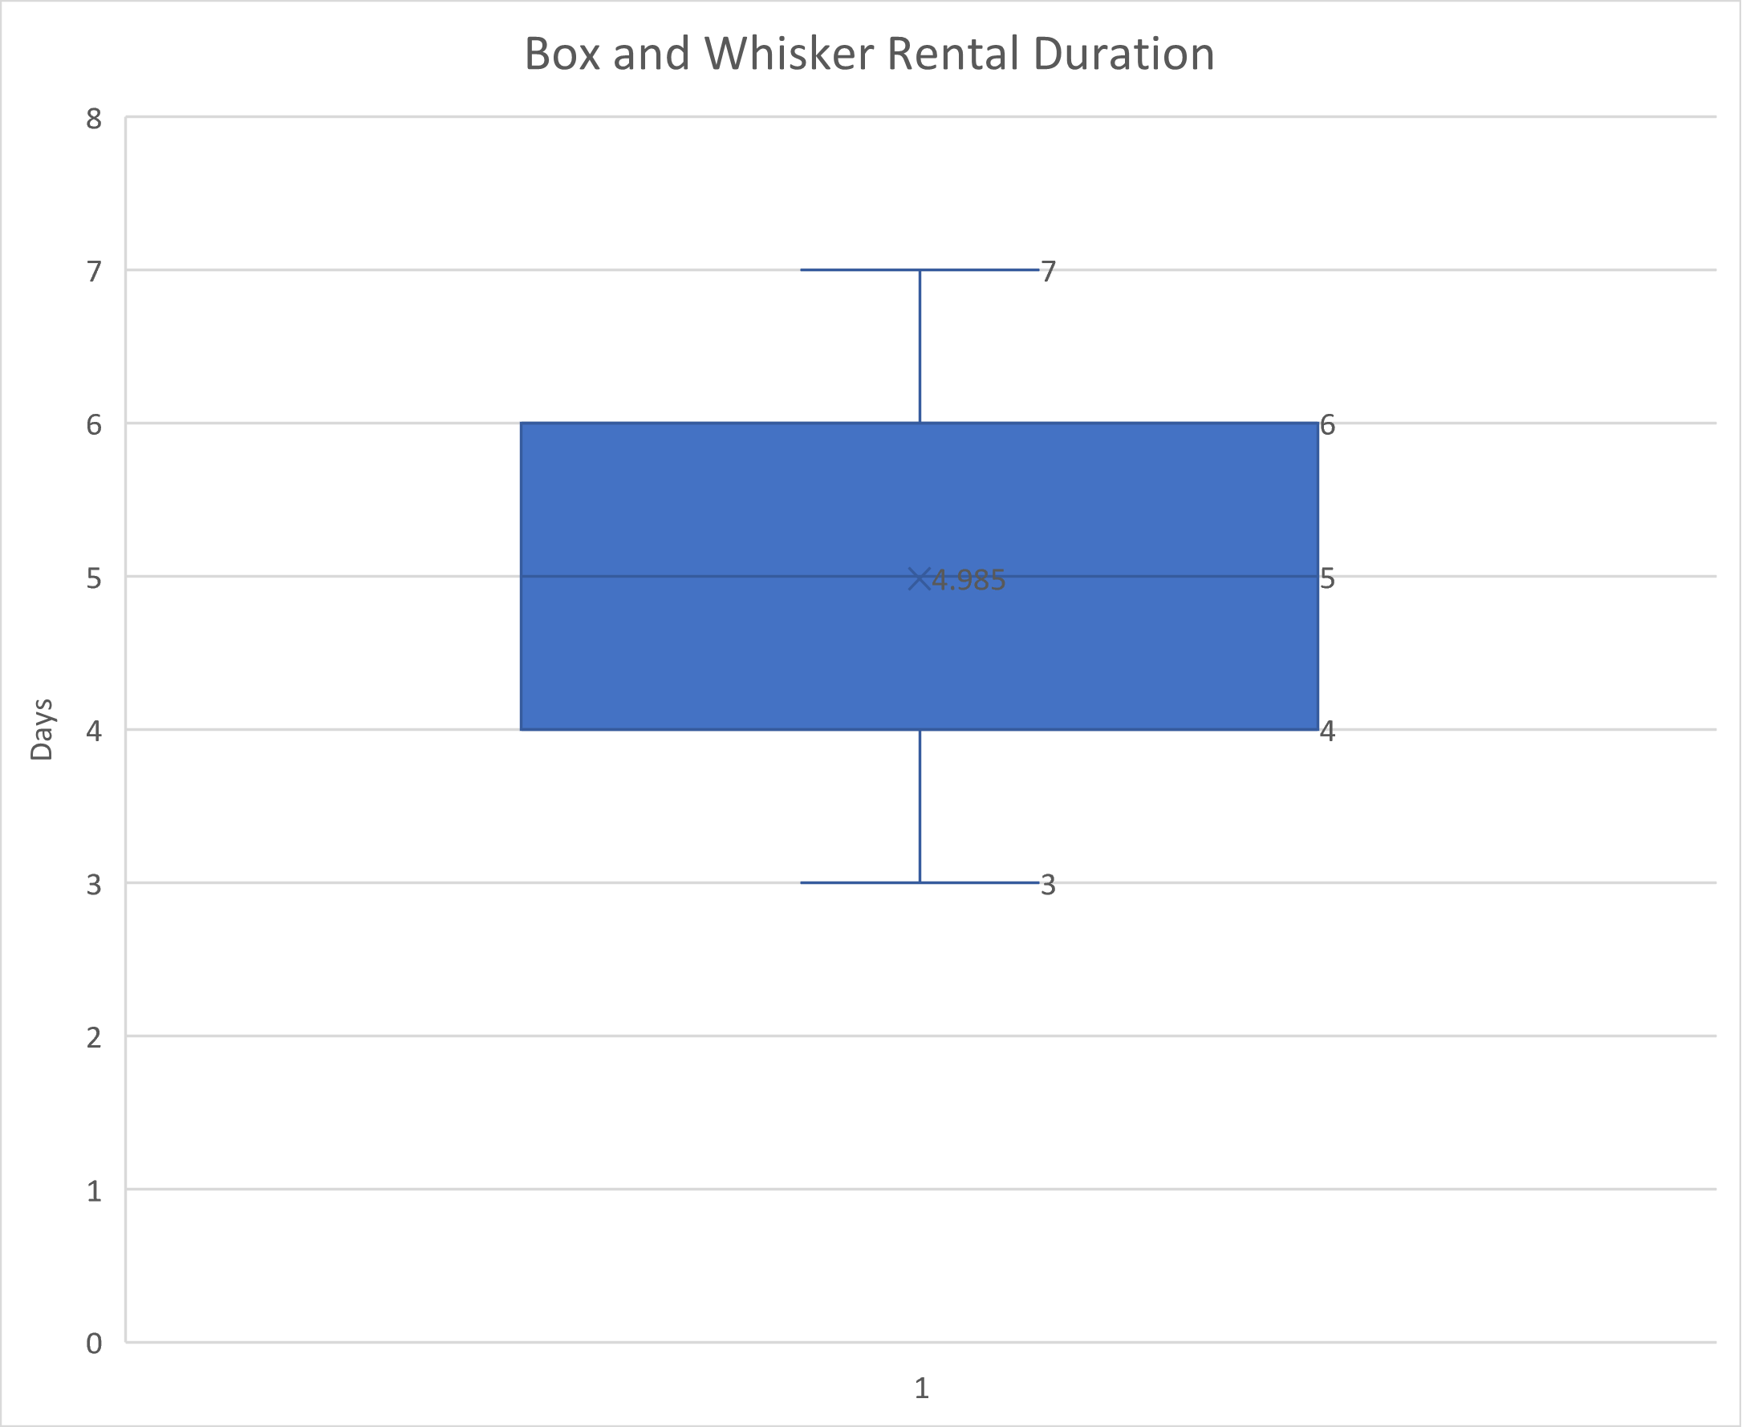
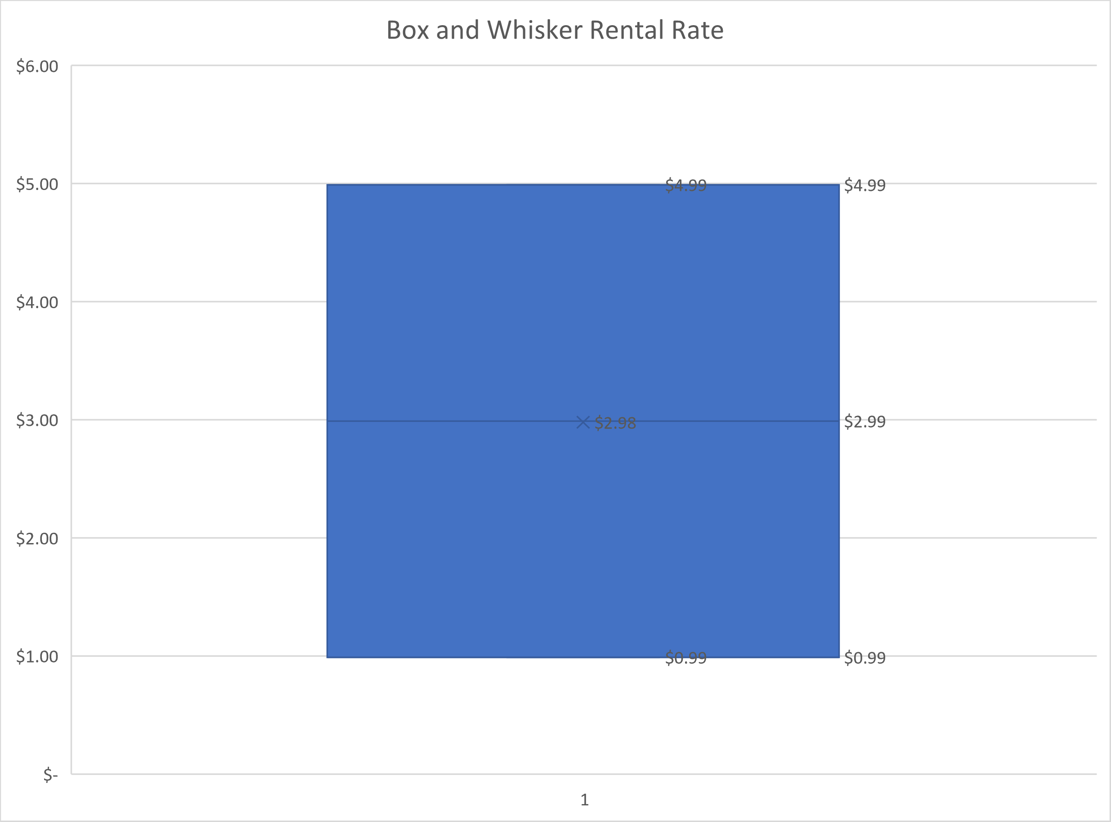
Data Statistics and Rental Deals
Min Rental Duration | Max Rental Duration | Avg / Median Rental Duration | Min Rental Rate | Max Rental Rate | Avg / Median Rental Rate
3 Days | 7 Days | 5 Days | $0.99 | $4.99 | $2.98

Slide 16
Data Statistics and Rental Deals Continued
Customers are shown to rent movies for 5 days at a rate of $2.98 on average. Deals for rentals pass the average rental duration should be offered. Rental deal rates should be below $2.98. This deal will incentivize customers to rent movies for longer.
Example: A customer rents a movie for 6 days. The original rental rate is $3.50 per day, but on the final day the rental rate is $2.
The deal rewards customers for their longer rentals and encourages longer rentals. This deal should be directed towards countries and regions, which have high populations, but more moderate purchasing power. India should have this strategy applied to it, since its users on average do not rent for long as seen with their average purchasing power despite its number of customers.

Slide 17
Customers With High Life Time Value
Customer ID | First Name | Last Name | Country | City | Total Amount Paid
426 | Bradley | Motley | India | Purnea (Purnia) | $125.74
158 | Veronica | Stone | United States | Greensboro | $115.70
537 | Clinton | Buford | United States | Aurora | $98.76
299 | James | Gannon | Japan | Hiroshima | $84.79
183 | Ida | Andrews | Brazil | Luzinia | $75.78
These are Rockbuster customers who have paid the most for rentals. They should be rewarded for being loyal customers and to incentivize them to continue their patronage. Rewards should include either discounts for future rentals or a free rental.
The rewards program should be applied to countries and regions with high purchasing power, such as the Philippines. These customers are likely to return the most and will be incentive to continue renting movies once they obtain a reward. If the customer has not made a rental in a while, a reward can entice them to return.

Slide 18
Summary and Conclusions
Rockbuster has customers spread all over the world and must use different strategies for each country / region
Popular films like Telegraph Voyage and Zorro Ark must be part of the Rockbuster movie global catalogue
Popular movie genres, such as Sports and Sci-Fi, should be promoted using rental deals, which encourages customers explore films in these genres. Unpopular genres such as Classics and children should not be prioritized.
The PG-13 rating is the most popular. These movies should be pushed in marketing, since customers are more likely to be interested in those films. Rockbuster’s core audience are adults and should not prioritize the G rating.
Regions with low purchasing power should be given a discount for longer rental times. Rentals pass the average 5 days should have their rental rate decreased lower than the average $2.98 rate starting on the 6th rental day. This discount encourages longer rental times.
Regions with high purchasing power should have a rewards program with either discounted rentals or a free rental. It will create a positive relationship between Rockbuster and its users.

Slide 19
Thank you!
Email: alexlam030@gmail.com

